Slide 1
Collaborative research environments and crowd-sourced science in MRI in MS
Hugo Vrenken, PhD Associate professor, dept. Radiology and Nuclear Medicine

Slide 2
Disclosures:
H. Vrenken has received research grants from MerckSerono, Novartis and Teva, speaker honoraria from Novartis, and consulting fees from MerckSerono; all funds paid directly to his institution.

Slide 3
“Big” data ... but how to use it?
Data have to be prepared
Collect, accumulate, curate
Pre-process
Including anonymization / pseudonymization / encoding
3
Notes:
In the previous talk, dr. Rocca discussed the developments in MS data sharing. Now how do we make the best use of these data? You heard about the preparations that go into getting data out there. How do we proceed? How can data be used, and by whom, to achieve the biggest impact on MS research? Before we get into that, by way of starting, let’s look at this important step in pre-processing to protect the personal information of study participants.

Slide 4
How to protect participant privacy ?
Remove all identifying metadata
from shared databases with clinical and other participant data
from image files
… done ?
4
Notes:
GDPR etc. Privacy, control over your own data. How to guarantee this in widely shared (or public) data? Remove all identifying fields of course. But then facial features still remain.

Slide 5
From structural MRI, we can reconstruct facial features
Problem solved ?
de Sitter et al., Eur Radiol in press
5
Notes:
Facial features can be reconstructed. That would look like this. To improve degree of anonymization, face can be removed. There are even 3 freely available software packages for this. So problem solved, right?

Slide 6
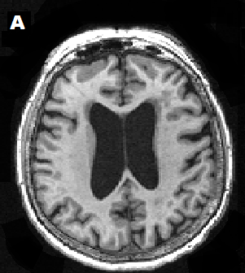
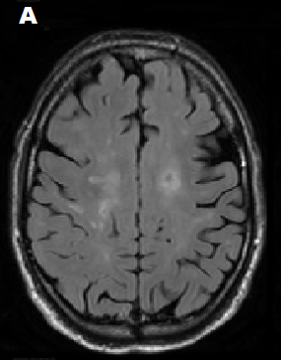
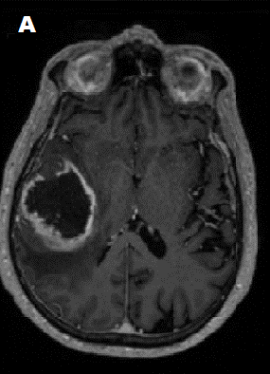
Facial features removal induces software failures
 | Facial features removal |  |  | Measurement
 | AD (n = 110) | MS (n =70) | Glioblastoma (n = 84) | AD (n = 110) SIENAX | MS (n =70) LST-LPA | Glioblastoma (n = 84) BraTumIA
Full |  |  |  | 110/110 100% | 70/70 100% | 83/84 99%
QuickShear | 110/110 100% | 70/70 100% | 82/84 98% | 110/110 100% | 67/70 96% | 68/82 83%
FaceMasking | 110/110 100% | 70/70 100% | 83/84 99% | 110/110 100% | 70/70 100% | 81/83 98%
Defacing | 110/100 100% | 70/70 100% | 84/84 100% | 110/110 100% | 57/70 81% | 83/84 99%
Table 2: Amount and percentage of images for which FFR methods completed successfully (Left half of table) and for which the automated methods SIENAX, LST-LPA and BraTumIA completed successfully (Right half of table). Abbreviations: AD = Alzheimer’s Disease and MS = multiple sclerosis.
Brain volumes:
SIENAX
MS lesions:
LST-LPA
Glioblastoma:
BraTumIA
de Sitter et al., Eur Radiol in press
6
Notes:
What about subsequent analysis? Here we compared results on native images with those obtained on images after removal of facial features, using 3 different face removal methods. First we tested if FFR worked in 3 different datasets: ADNI, MS and GBM.

Slide 7
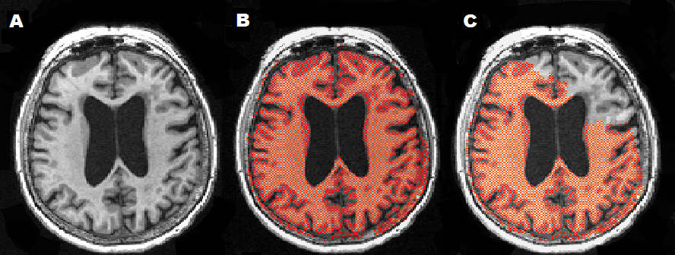
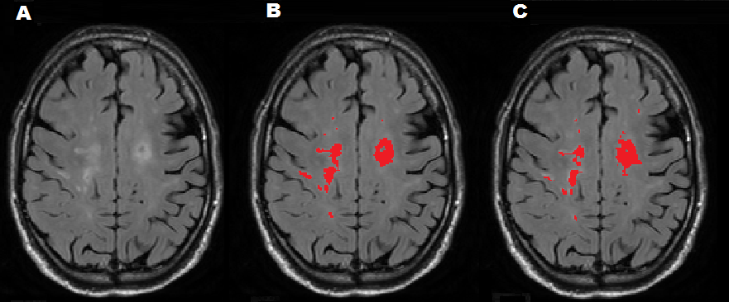
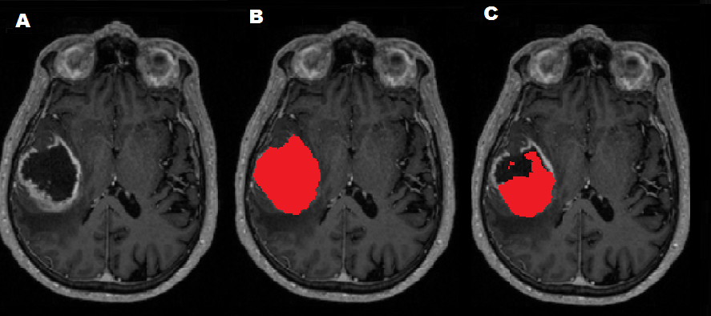
Facial features removal can affect subsequent analysis
After facial features removal
Original
de Sitter et al., Eur Radiol in press
7
Notes:
Facial features can be reconstructed. To improve degree of anonymization, face can be removed. What about subsequent analysis? Here we compared results on native images with those obtained on images after removal of facial features, using 3 different face removal methods. Next we investigated volumetric agreement. For MS lesions, relatively good (ICC>0.98). For brain volumes, worse: for NBV, all ICC<0.9. For BV better, ICC>0.93.

Slide 8
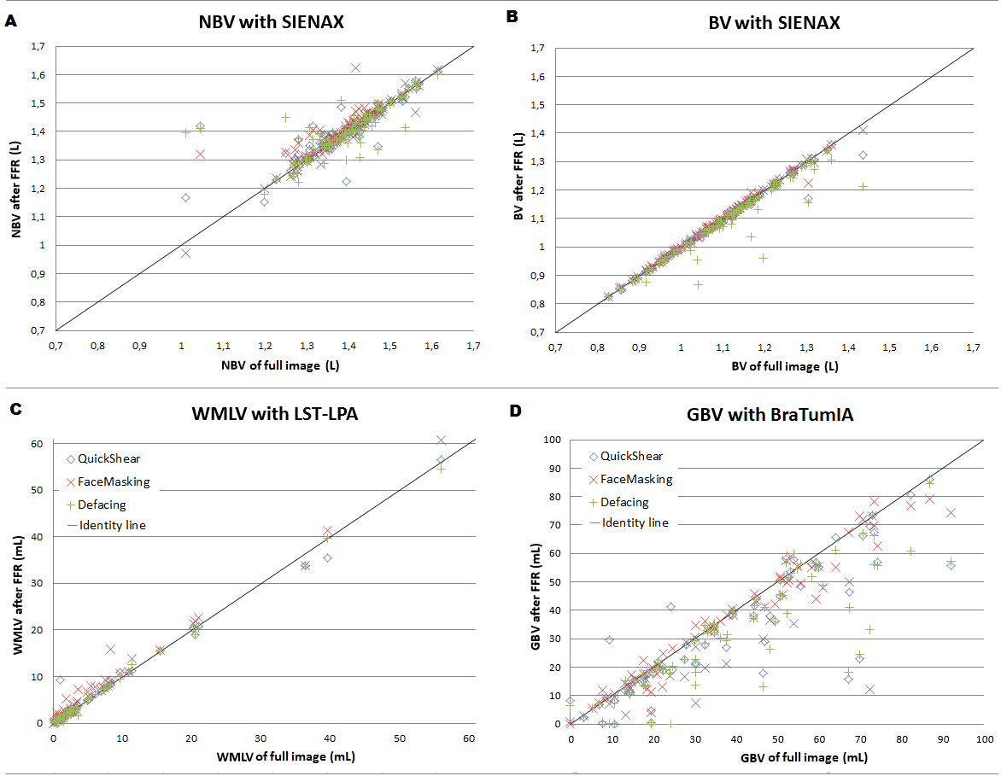
Facial features removal can affect subsequent analysis ...substantially & systematically
de Sitter et al., Eur Radiol in press
8
Notes:
Facial features can be reconstructed. To improve degree of anonymization, face can be removed. What about subsequent analysis? Here we compared results on native images with those obtained on images after removal of facial features, using 3 different face removal methods. Next we investigated volumetric agreement. For MS lesions, relatively good (ICC>0.98). For brain volumes, worse: for NBV, all ICC<0.9. For BV better, ICC>0.93.

Slide 9
Facial features removal hampers subsequent image analysis
Implications
Adapt image analysis software to handle images after facial features removal
Open sharing of full images not advised without explicit consent from participant
9
Notes:
Facial features can be reconstructed. To improve degree of anonymization. What about subsequent analysis? Here we compared results on native images with those obtained on images after removal of facial features, using 3 different face removal methods.

Slide 10
“Big” data ... but how to use it?
Data have to be prepared
Collect, accumulate, curate
Pre-process
Including anonymization / pseudonymization / encoding
Data have to be used
By other researchers
By others
Notes:
In the previous talk, dr. Rocca discussed the developments in MS data sharing. Now how do we make the best use of these data? You heard about the preparations that go into getting data out there. How do we proceed? How can data be used, and by whom, to achieve the biggest impact on MS research?

Slide 11
Outline
Collaborative research environments
Bringing researchers together
Examples
Crowd-sourced science
What is crowd-sourcing?
Examples
How can we use it for MS?
11
Notes:
In this talk I will highlight two ways of going about this. One concerns collaborative research environments, which exist in varying shapes and forms, but all of them enabled by the developments in computing power and connection speeds over the past decade or so. The second is crowd-sourcing.

Slide 12
Outline
Collaborative research environments
Bringing researchers together
Examples
Crowd-sourced science
What is crowd-sourcing?
Examples
How can we use it for MS?
12
Notes:
In this talk I will highlight two ways of going about this. One concerns collaborative research environments, which exist in varying shapes and forms, but all of them enabled by the developments in computing power and connection speeds over the past decade or so. The second is crowd-sourcing.

Slide 13
Collaborative research environments
Databases / repositories
Challenges
Processing environments / pipeline running
Interactive environments
SPINE
Open Neuroimaging Laboratory
13
Notes:
There are different flavors of CREs. Simple databases, environments where you can run analyses, and finally interactive environments

Slide 14
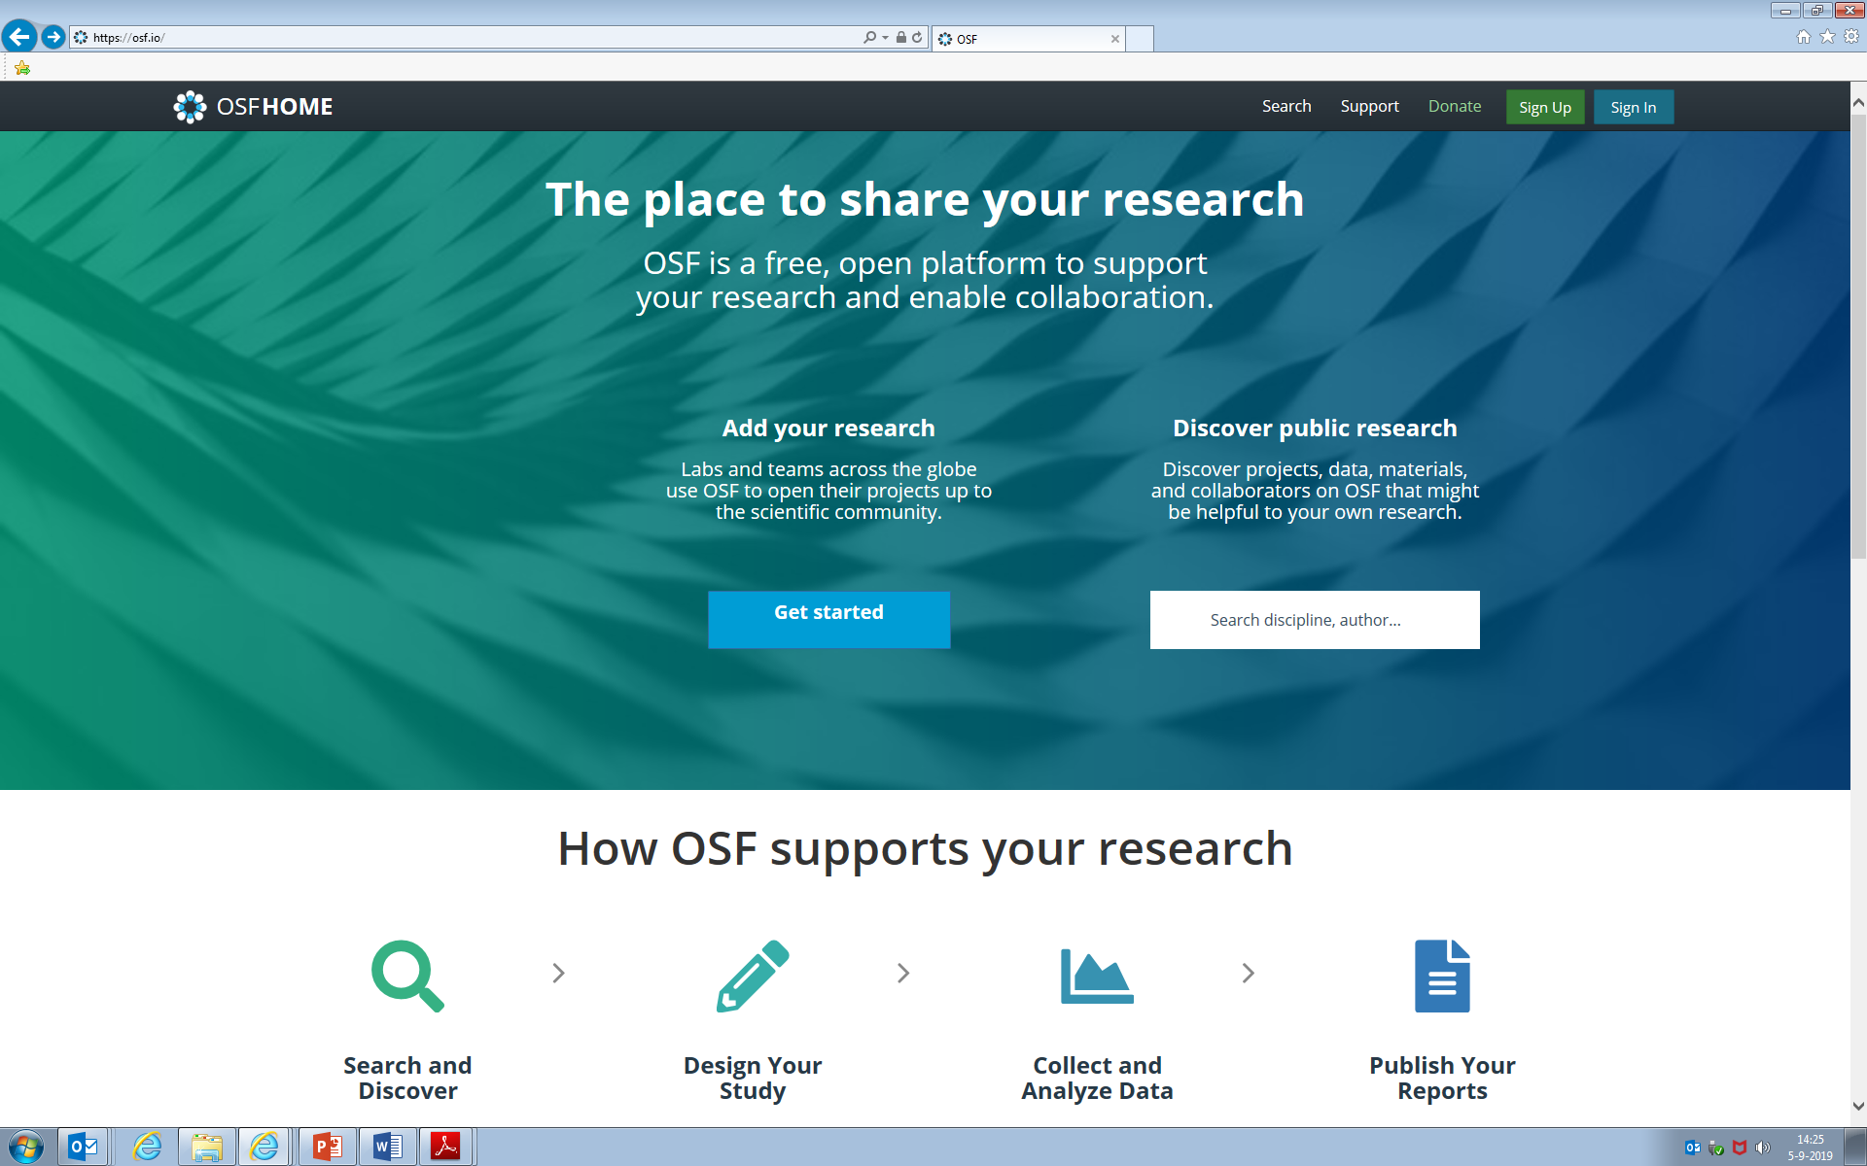
https://osf.io
Data sharing environment…
14
Notes:
OSF is an example of an environment for sharing data in databases or repositories

Slide 15
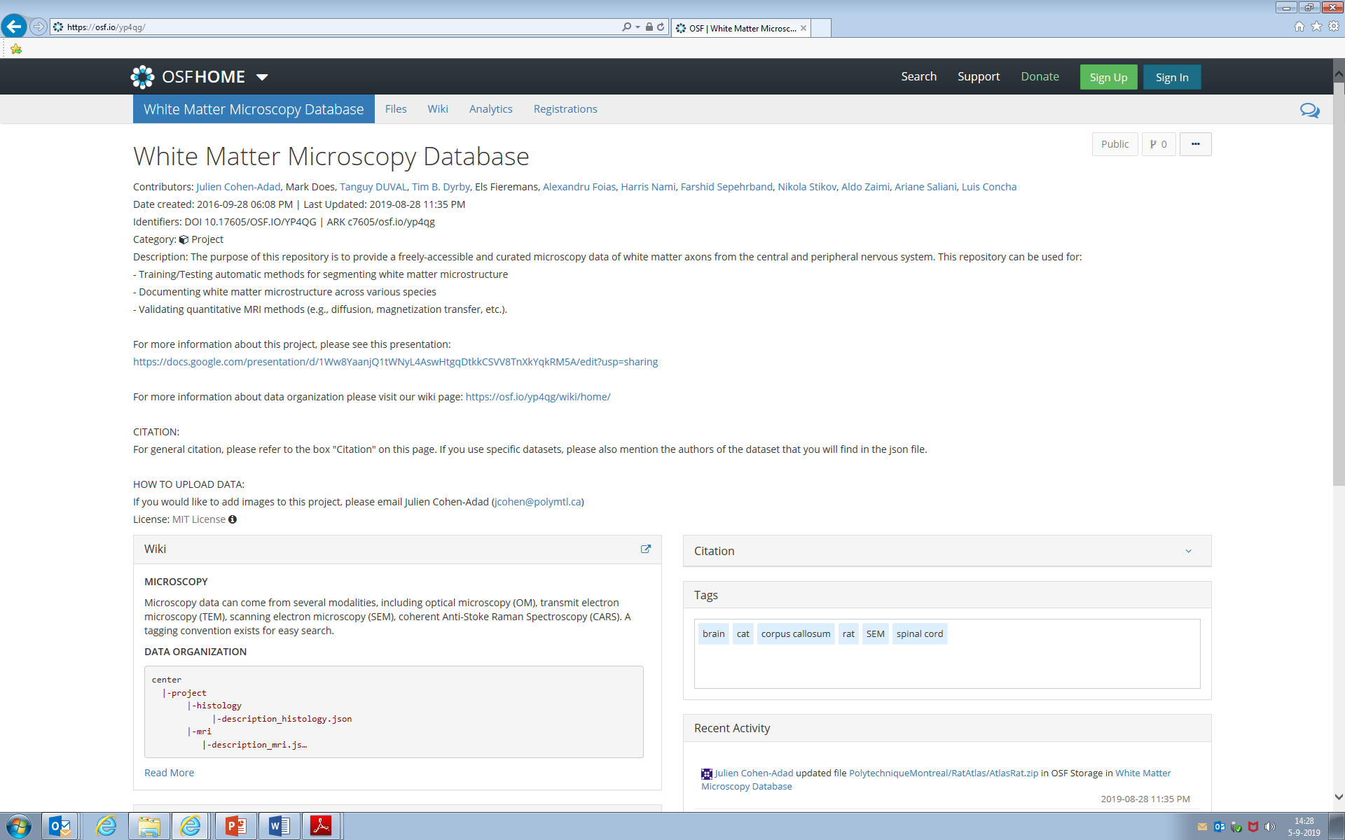
https://osf.io/yp4qg/
15
Notes:
There is some work on OSF that is relevant to our community, such as the white matter microscopy database championed by Julien Cohen-Adad, Tim Dyrby, Els Fieremans, Niola Stikov and others.

Slide 16
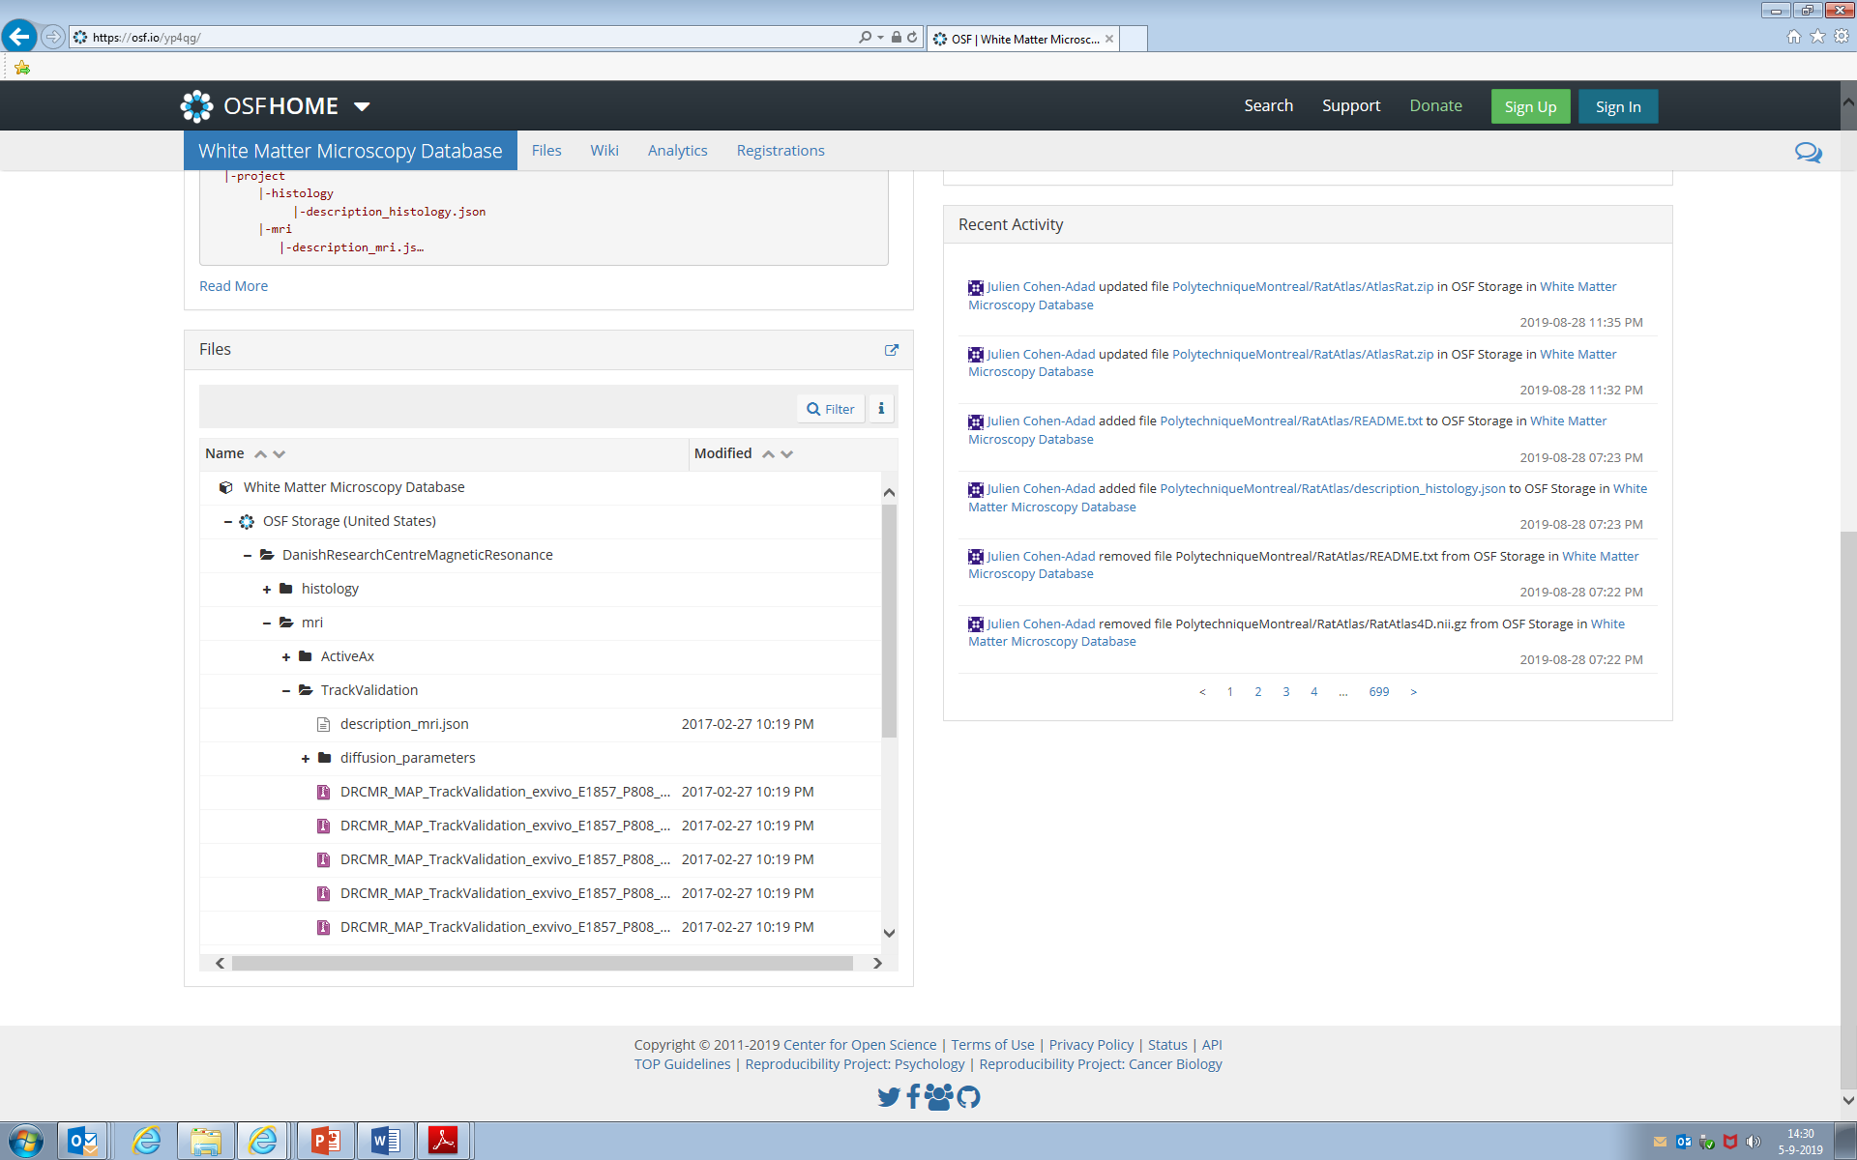
Datasets…
16
Notes:
And taking that as an example, you can see here how data is organized and accessible, including MRI data, in this case diffusion MRI.

Slide 17
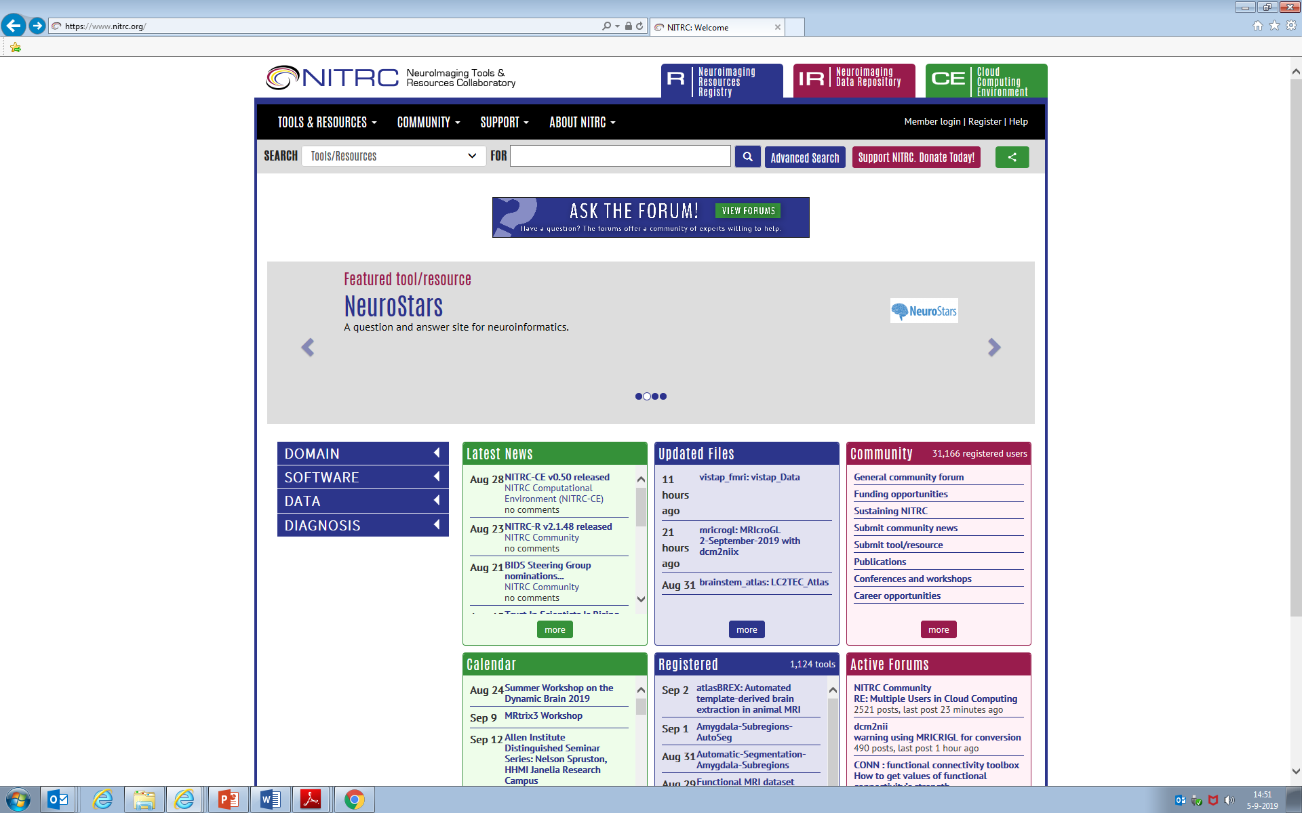
Sharing of data and tools…
https://www.nitrc.org
17
Notes:
Another example, NITRC, comes from the neuroinformatics community and is an online environment for sharing both tools and data.

Slide 18
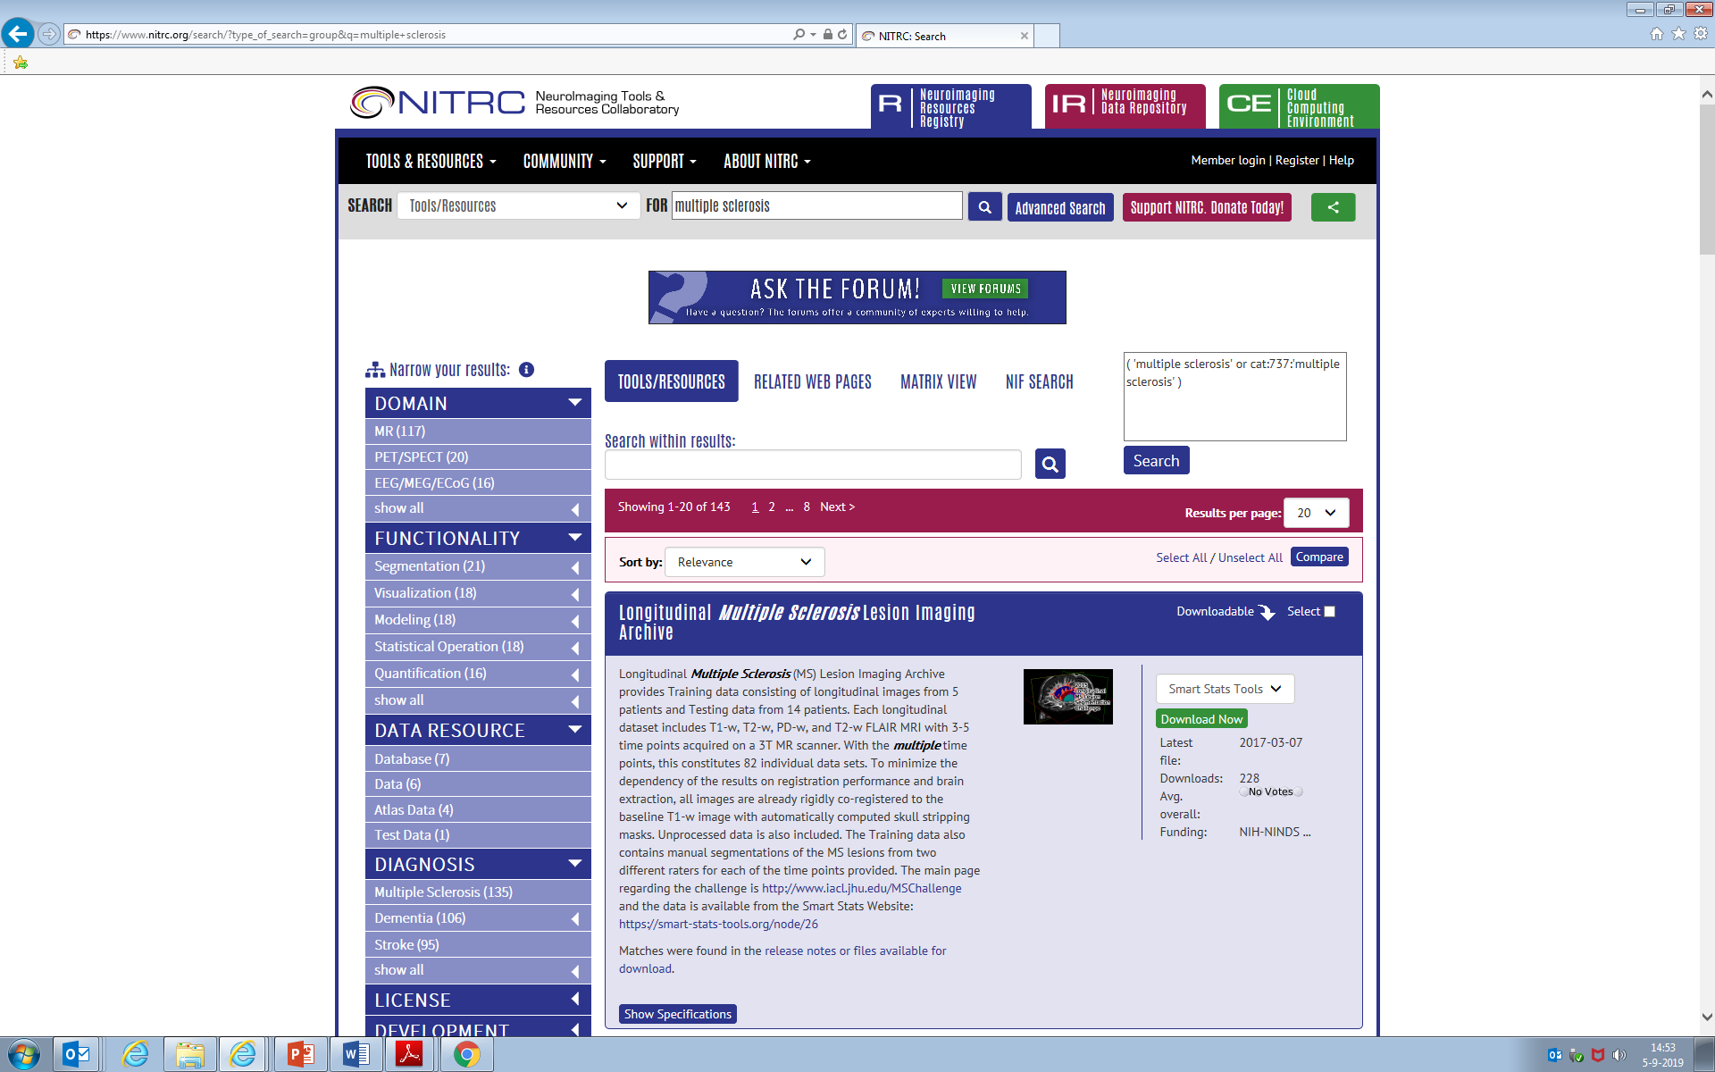
18
Notes:
Searching for multiple sclerosis on NITRC gets you about 145 hits, the first of which is about the longitudinal MS lesion segmentation challenge from 2015 organized by Dzung Pham.

Slide 19
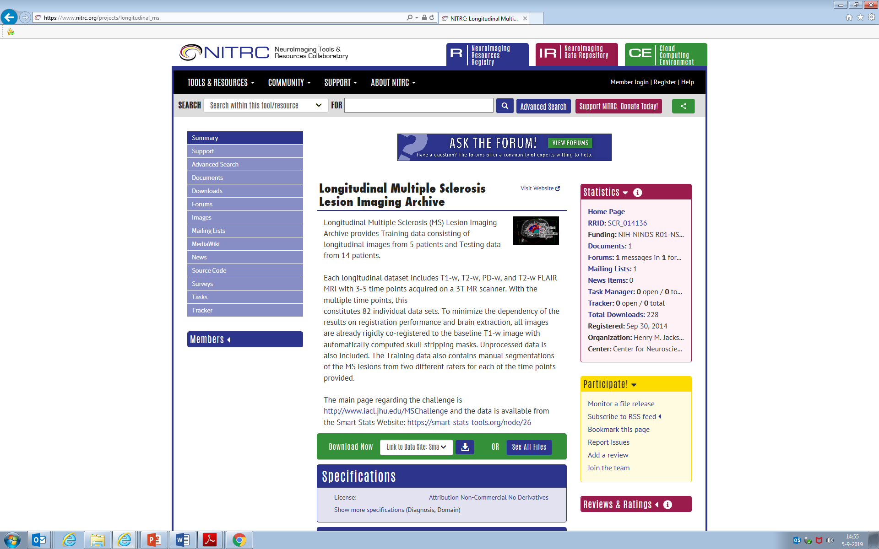
Datasets…
19
Notes:
Clicking on that item gets us to its own subpage of NITRC, with links to data and other information.

Slide 20
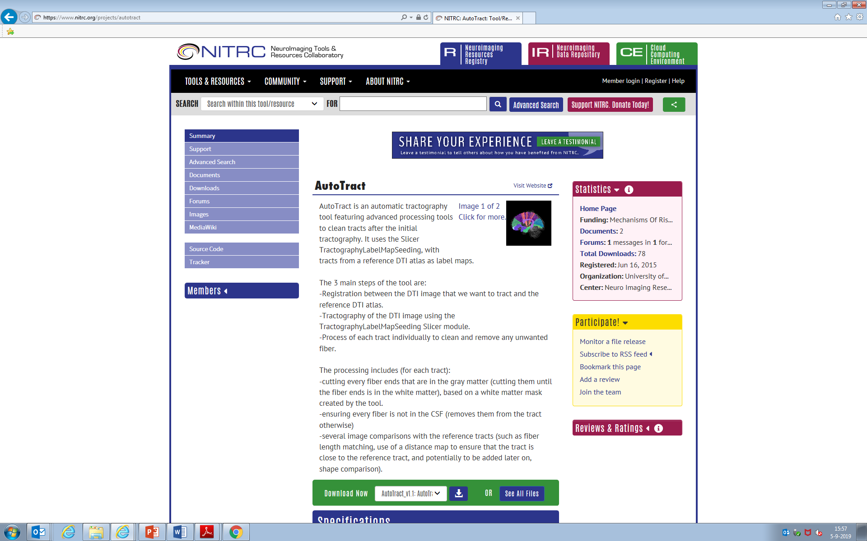
Tools…
Download
Install
Run
Is NITRC for the Nerds in the Research Community?
20
Notes:
NITRC also hosts tools, such as this random example from diffusion tractography analysis. The typical NITRC approach is that you will then download these tools to install and run them on your own computer systems. One might be forgiven therefore to think that maybe NITRC is for the “nerds in the research community” like myself… If you think that this is not suitable for you, there are also alternative approaches that allow you to use tools directly.

Slide 21
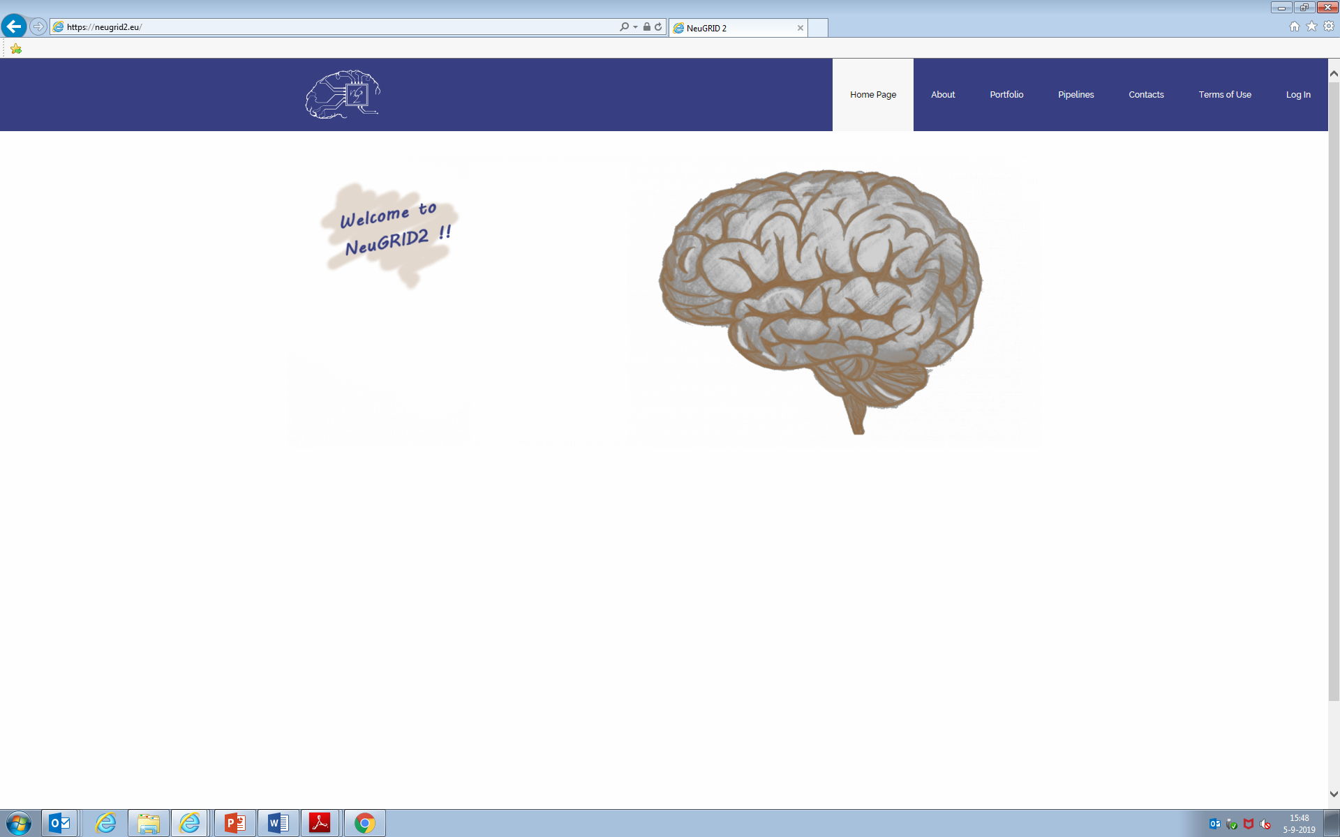
Environment for executing pipelines…
https://neugrid2.eu
21
Notes:
Neugrid is an online platform for performing image analysis. It does not require you to install software locally. There are other examples too, including research centers that provide online access to their tools, e.g. Niftyweb.

Slide 22
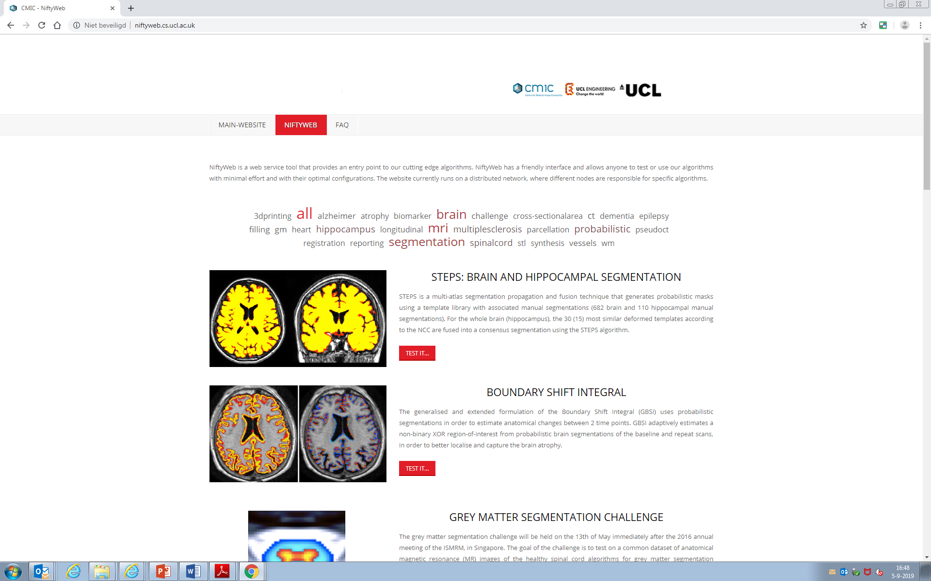
Online access to pipelines from particular research centers, e.g., NiftyWeb from UCL
http://niftyweb.cs.ucl.ac.uk/
22
Notes:
Neugrid is an online platform for performing image analysis. It does not require you to install software locally. There are other examples too, including research centers that provide online access to their tools, e.g. Niftyweb.

Slide 23
Interactive collaborative research environments
Two examples:
The Open Neuroimaging Laboratory (http://openneu.ro)
SPINE (https://spinevirtuallab.org)
23

Slide 24
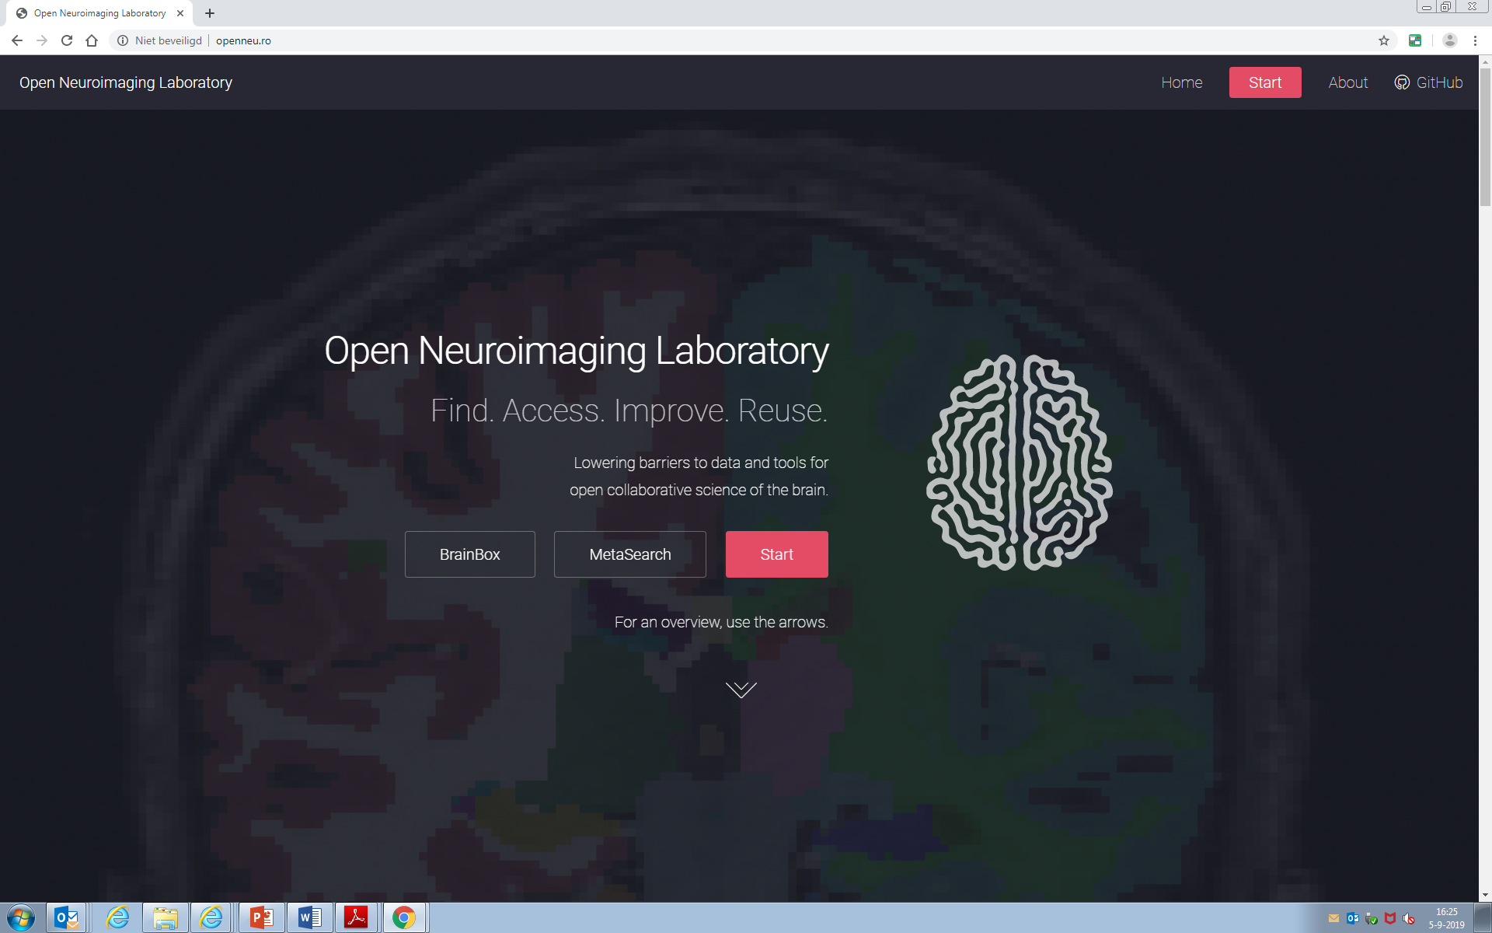
First example: Open Neuroimaging Laboratory
http://openneu.ro
24

Slide 25
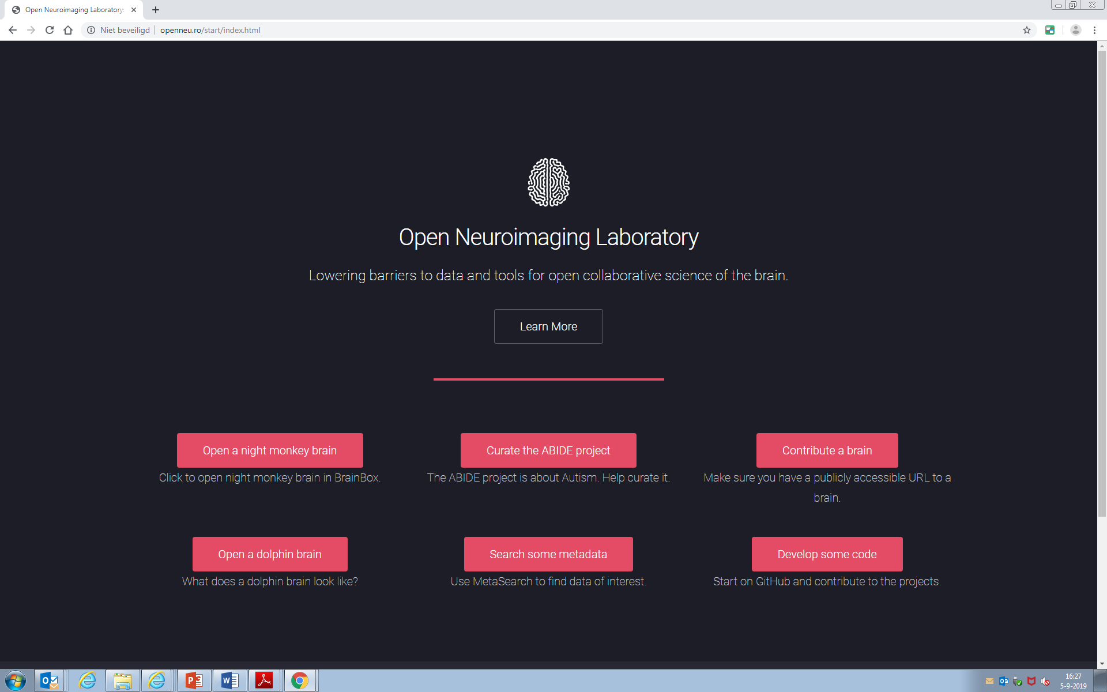
25

Slide 26
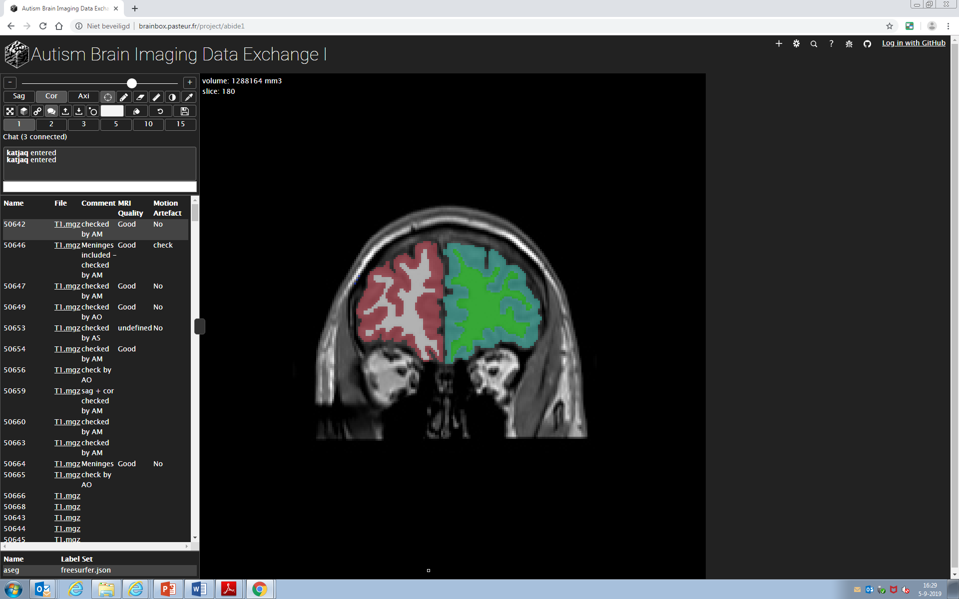
Inspect
Edit
Approve
26
Notes:
Here I can curate the image data and the FreeSurfer segmentations of the ABIDE project, to help autism research.

Slide 27
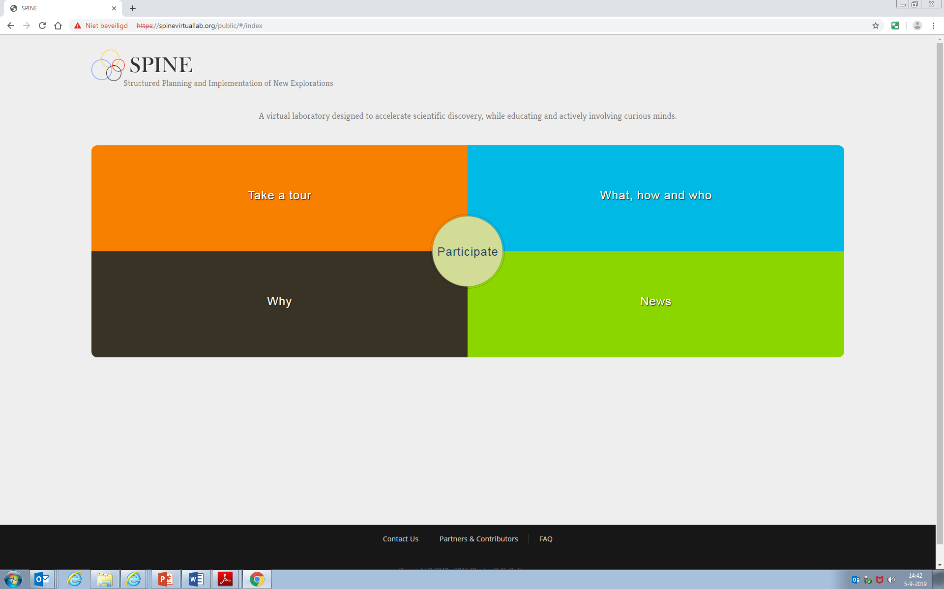
Second example: SPINE
https://spinevirtuallab.org
27
Notes:
SPINE is another example of a collaborative research environment. This is a screenshot of the current version of SPINE, soon to be replaced with a completely new version.

Slide 28
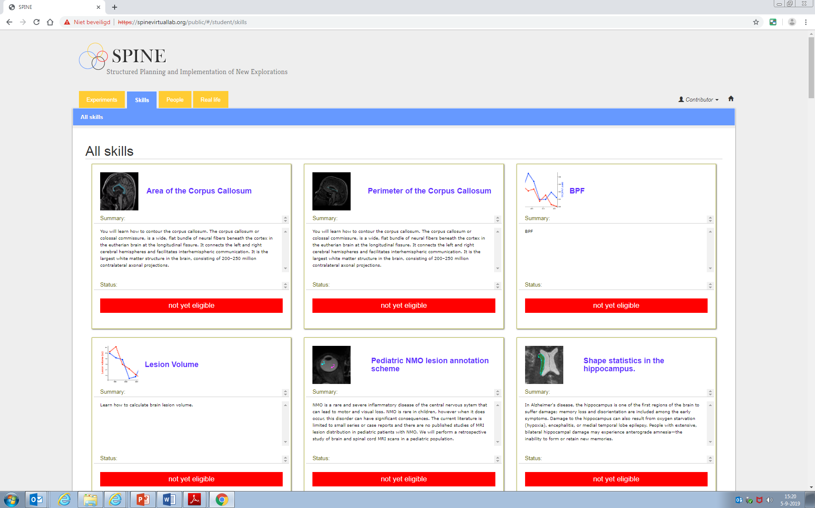
28

Slide 29
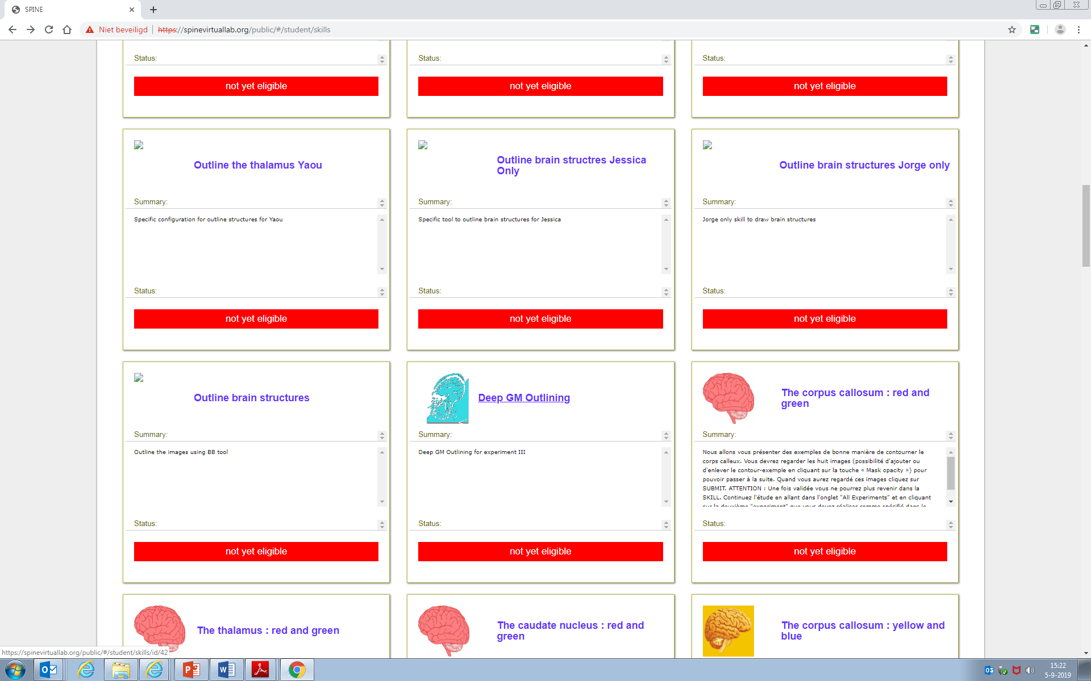
29

Slide 30
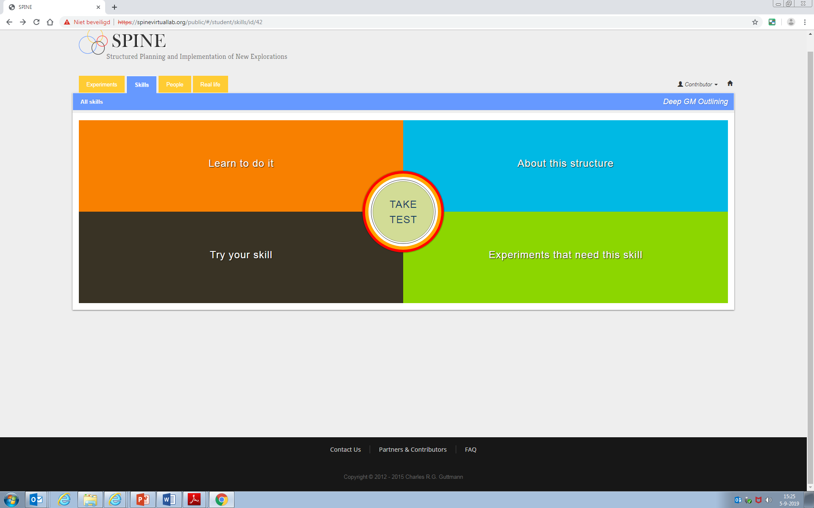
30

Slide 31
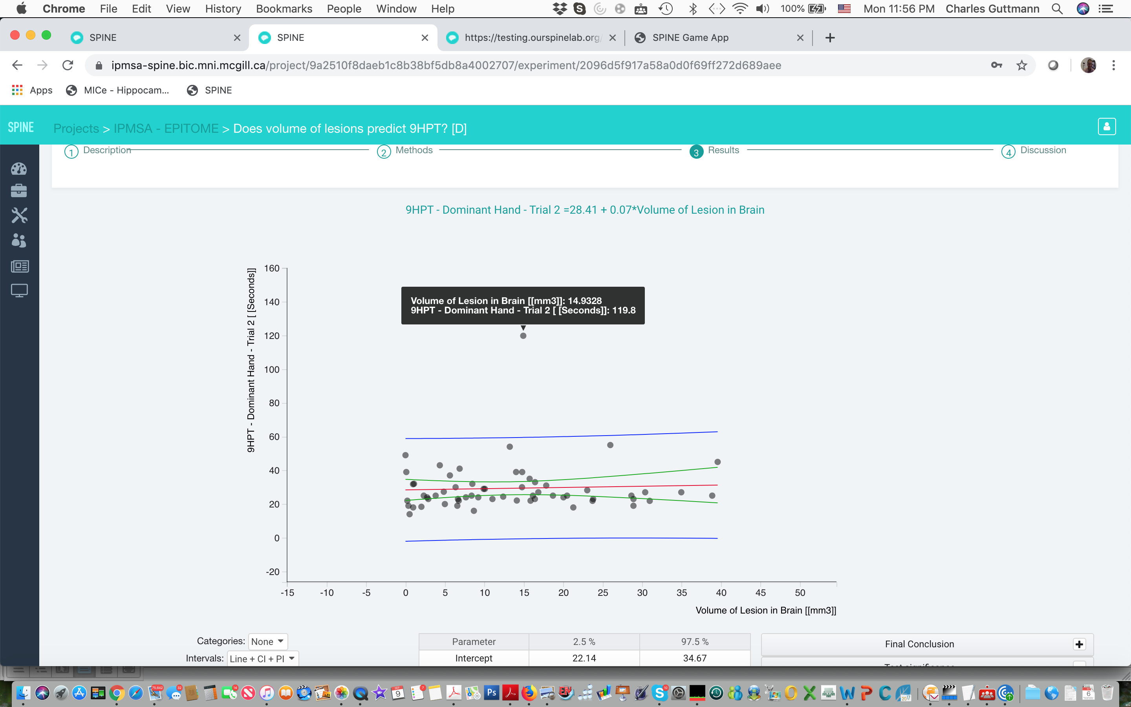
Querying results in SPINE
31
Notes:
Now there are several advantages to such an approach, beyond the obvious one that you can now collaborate from all over the world. Because all data are here, I can query data points on the fly – here for example I can interrogate a lesion segmentation someone made.

Slide 32
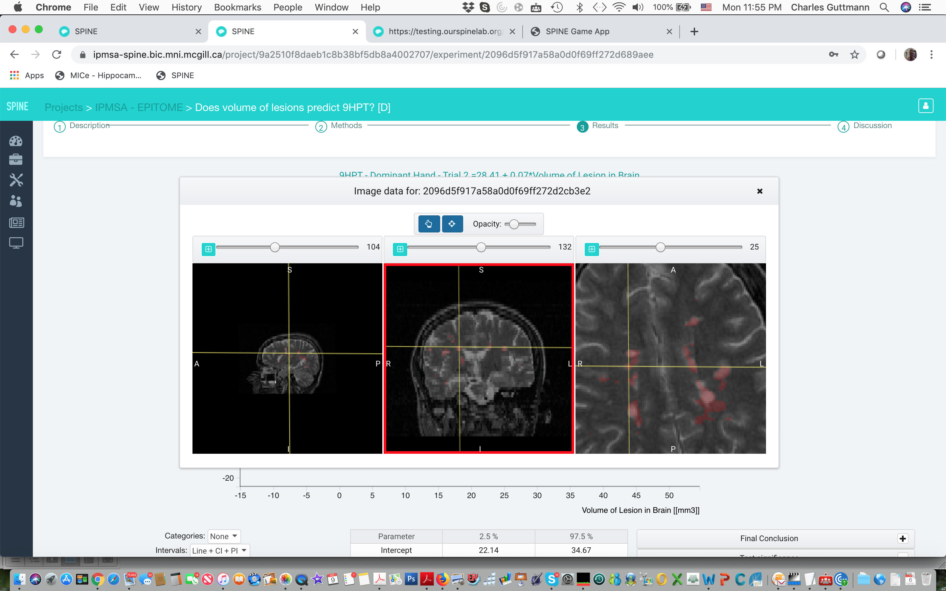
Querying results in SPINE
32
Notes:
Now there are several advantages to such an approach, beyond the obvious one that you can now collaborate from all over the world. Because all data are here, I can query data points on the fly – here for example I can interrogate a lesion segmentation someone made.

Slide 33
General approach of sites like Open Neuroimaging Laboratory and SPINE
Users can have different roles
Scientists
define tasks
make training material
design experiments
analyze results
Contributors
perform tasks
can be in the form of a game
interact with user community
33
Notes:
In this talk I will highlight two ways of going about this. One concerns collaborative research environments, which exist in varying shapes and forms, but all of them enabled by the developments in computing power and connection speeds over the past decade or so. The second is crowd-sourcing.

Slide 34
Outline
Collaborative research environments
Bringing researchers together
Examples
Crowd-sourced science
What is crowd-sourcing?
Examples
How can we use it for MS?
34
Notes:
In this talk I will highlight two ways of going about this. One concerns collaborative research environments, which exist in varying shapes and forms, but all of them enabled by the developments in computing power and connection speeds over the past decade or so. The second is crowd-sourcing.

Slide 35
Outline
Collaborative research environments
Bringing researchers together
Examples
Crowd-sourced science
What is crowd-sourcing?
Examples
How can we use it for MS?
35
Notes:
In this talk I will highlight two ways of going about this. One concerns collaborative research environments, which exist in varying shapes and forms, but all of them enabled by the developments in computing power and connection speeds over the past decade or so. The second is crowd-sourcing.

Slide 36
Crowd-sourcing - what is it?
NOT crowd-funding
Provide time & effort rather than money
Anybody can contribute
Perform small tasks in actual scientific research projects
36
Notes:
Sometimes to describe what something is, it can be useful to discuss what it’s not. Many people will make the link with crowd-funding. Crowd-sourcing is not crowd-funding.

Slide 37
Crowd-sourcing
Examples exist in many fields
37

Slide 38
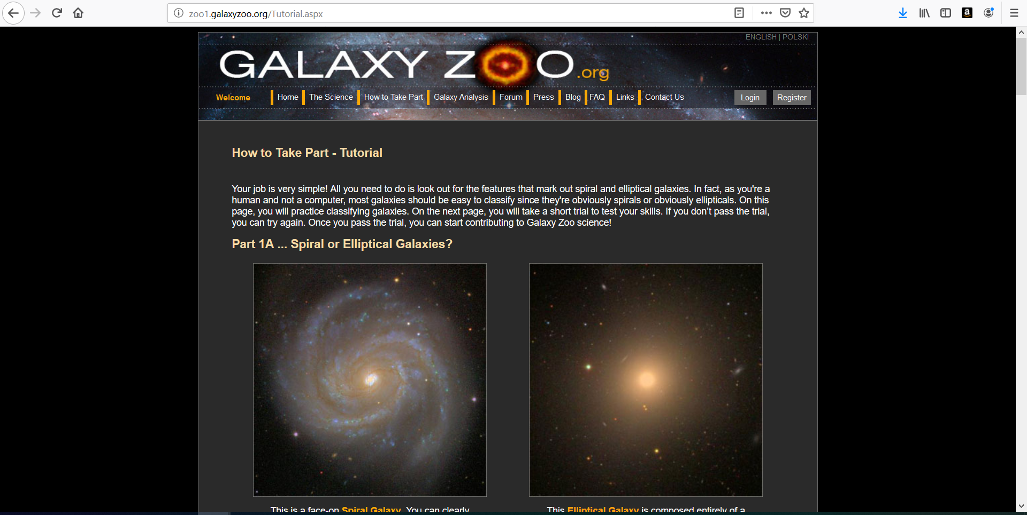
38

Slide 39
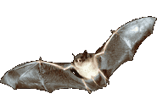
Crowd-sourcing
Examples exist in many fields
… can it be useful in MS imaging?
39

Slide 40
Can crowd-sourcing be useful in MS imaging?
I would say yes…
General tasks like “curating” data, as in the ABIDE example
Helping to overcome specific problems in MS imaging
40

Slide 41
Example from structural imaging: Atrophy measurement challenges in MS
Impaired performance of automated segmentation in MS
Due to lesions, atrophy, diffuse changes
These affect image intensity histograms, registration, brain extraction, …
Amiri, de Sitter et al., Neuroimage: Clinical 2018
41

Slide 42
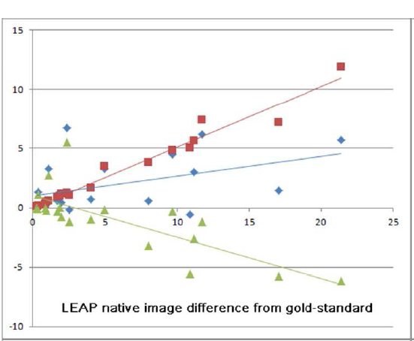
WM lesions affect GM segmentation
GM volume difference from gold standard (mL)
Overestimation inside lesions
Underestimation outside lesions
Lesion volume (mL)
Popescu et al., Neuroimage: Clinical 2014; Amiri, de Sitter et al., Neuroimage: Clinical 2018
42
Poster P896 presents some of our recent work on this topic
Notes:
White matter lesions affect the measurement of GM volumes

Slide 43
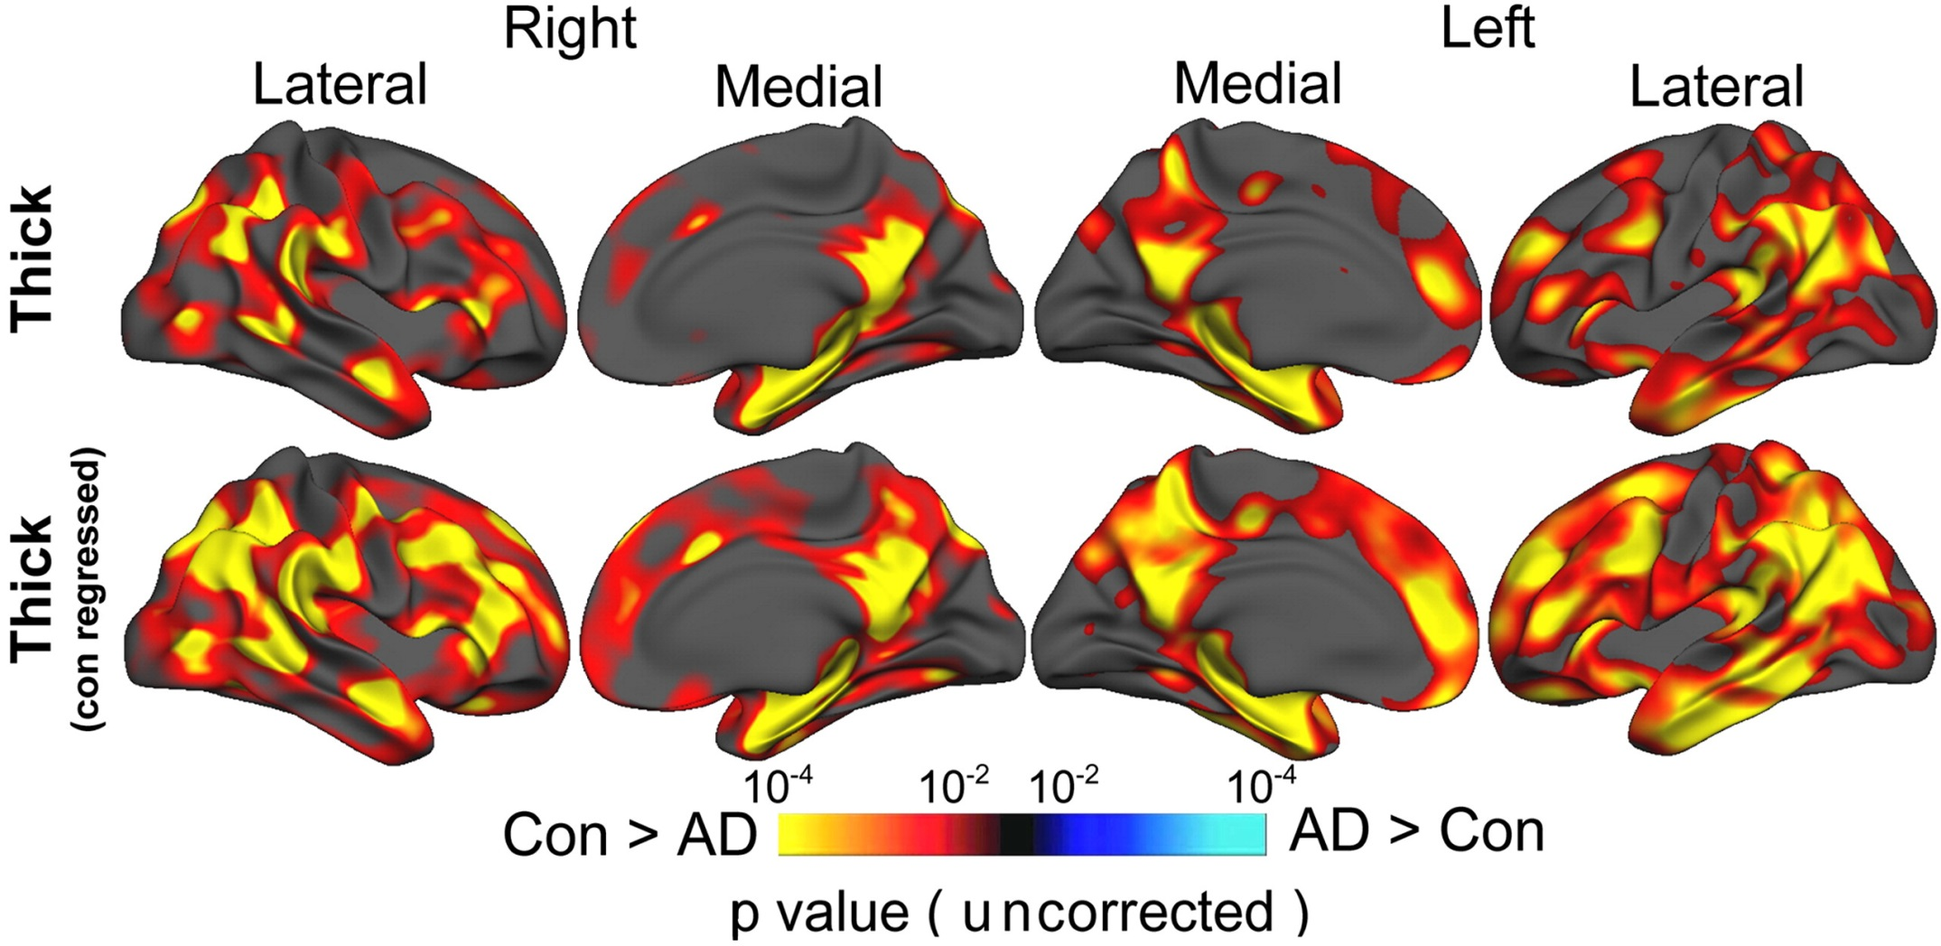
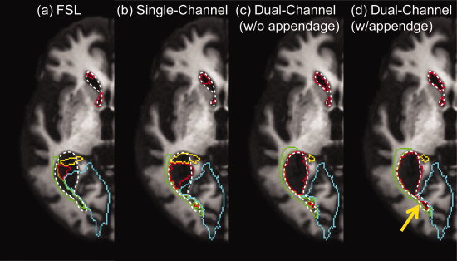
Automated segmentation in MS also affected by atrophy and diffuse/subtle changes
Westlye Neuroimage 2009
Djamanakova JMRI 2013
43
Notes:
GM volume measurements are also affected by the presence of atrophy –example on the left showing how image co-registration has to be adjusted to cope with cases with a lot of atrophy-, and of diffuse or subtle tissue intensity changes –example on the right showing tissue contrast between cortical GM and neighboring WM being affected in AD, and how this can be statistically overcome.

Slide 44
Annotations in MS image data can help!
“Annotations” could be:
outlines of anatomical structures
markers on lesions
corrections on automated analyses
etc.
44

Slide 45
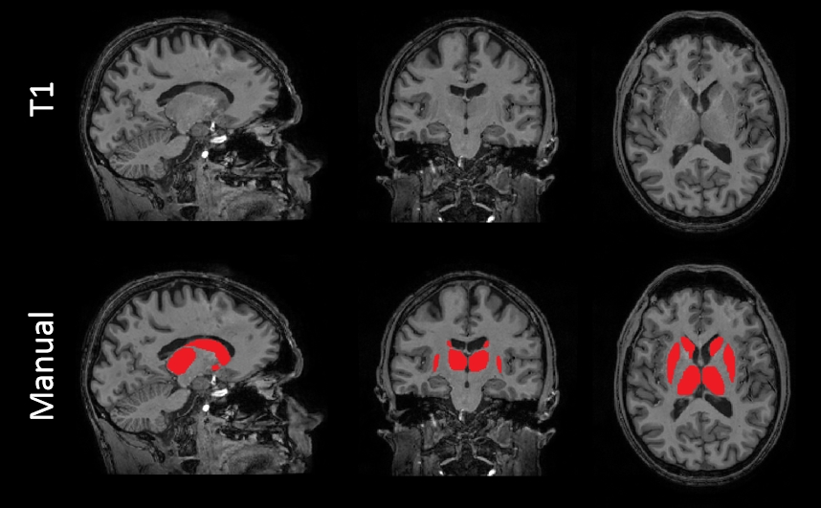
Annotations in MS image data can help!
“Annotations” could be:
outlines of anatomical structures
markers on lesions
corrections on automated analyses
etc.
Use these to train software
Experts are too expensive!
Outline on every single slice at 1x1x1 mm³ resolution
45

Slide 46
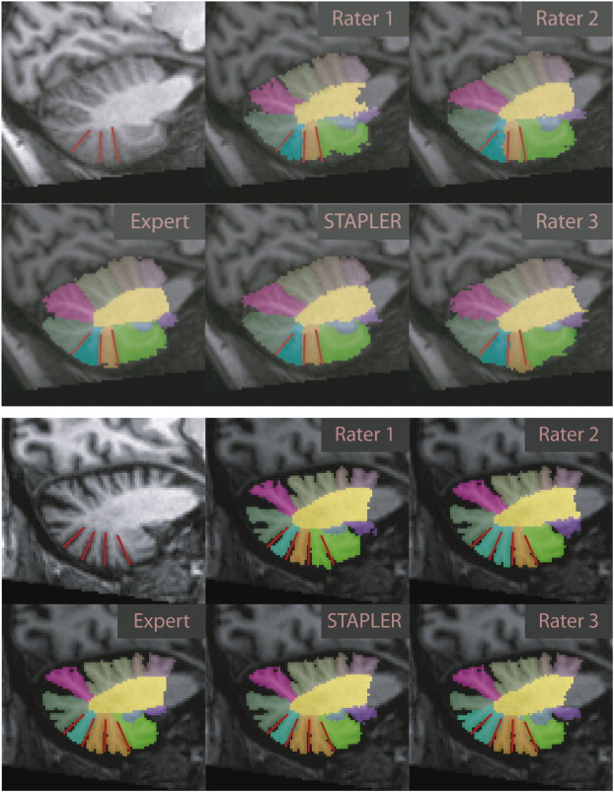
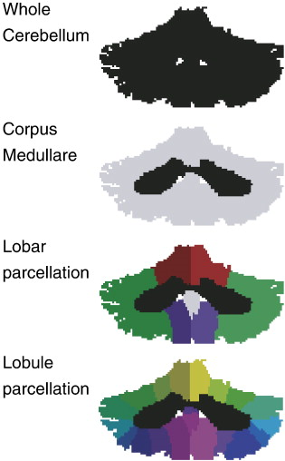
Opportunities for crowd-sourced analysis
Outlining of anatomical structures by non-experts?
Will they be good enough?
There is some encouraging data…
Bogovic Neuroimage 2013
46
Notes:
Sticking with the example of GM segmentation, can we push the MS field forward by getting “the crowd” to contribute outlines of GM structures?

Slide 47
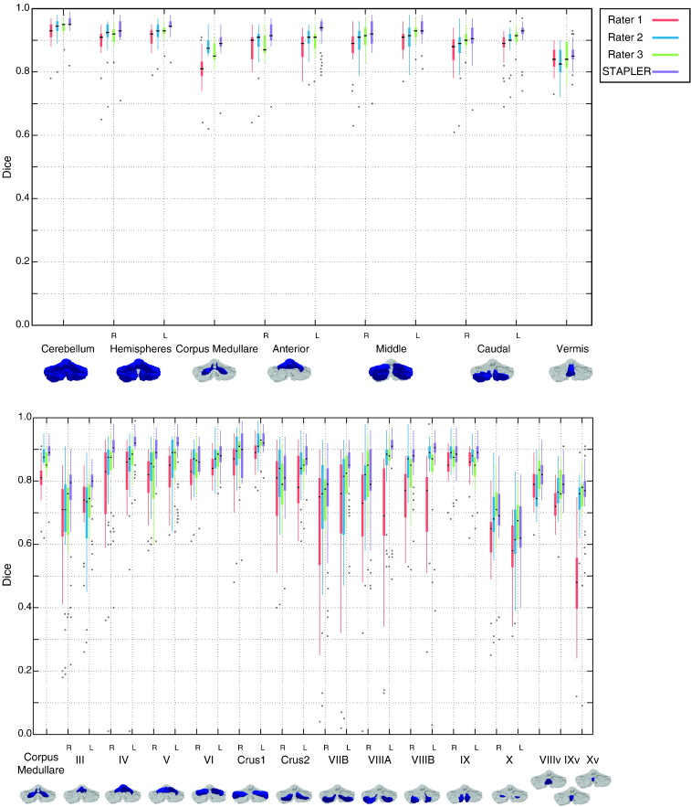
“Non-experts” can produce good outlines
Cerebellar sub-labeling in 3-D by “moderately trained” non-experts gives good performance
“moderately trained” = 150 h of training !!
47

Slide 48
Opportunities – analysis of MS images by non-experts
Outlining of anatomical structures by non-experts?
Relevance in MS
Impaired performance of automated segmentation
Due to lesions, atrophy, diffuse changes
Possible road to success:
Create reference segmentations through “the crowd”
Use MS outlines to train better, MS-specific software
But reduce workload:
Outline fewer slices and reconstruct full shape
48

Slide 49
Sparse outlining of GM structures in MS
49
Notes:
Here we tested reconstruction of a full surface from a small number of outlines using FASTSURF. FASTSURF was developed for hippocampal segmentation in the context of dementia and radiotherapy treatment planning. Here we tested it for segmenting caudate nucleus, thalamus and putamen in MS cases.

Slide 50
Sparse outlining of GM structures in MS
Sparse outlining – not on every slice
FASTSURF method: Bartel et al., Plos One 2019
50
Notes:
Here we tested reconstruction of a full surface from a small number of outlines using FASTSURF. FASTSURF was developed for hippocampal segmentation in the context of dementia and radiotherapy treatment planning. Here we tested it for segmenting caudate nucleus, thalamus and putamen in MS cases.

Slide 51
Sparse outlining of GM structures in MS
de Sitter, in preparation
51
Notes:
Here we tested reconstruction of a full surface from a small number of outlines using FASTSURF. FASTSURF was developed for hippocampal segmentation in the context of dementia and radiotherapy treatment planning. Here we tested it for segmenting caudate nucleus, thalamus and putamen in MS cases.

Slide 52
Good reproduction of full outlines
Good agreement of volumes
de Sitter, in preparation
52
Notes:
Here we tested reconstruction of a full surface from a small number of outlines using FASTSURF. FASTSURF was developed for hippocampal segmentation in the context of dementia and radiotherapy treatment planning. Here we tested it for segmenting caudate nucleus, thalamus and putamen in MS cases.

Slide 53
Summary
Collaborative research environments
Repositories for data, software
Interactive collaborations
Crowd-sourced science
Active participation from non-scientists
Potential for applications in MS imaging
Particularly regarding image annotations needed for deep learning etc.
53
Notes:
In this talk I will highlight two ways of going about this. One concerns collaborative research environments, which exist in varying shapes and forms, but all of them enabled by the developments in computing power and connection speeds over the past decade or so. The second is crowd-sourcing.

Slide 55
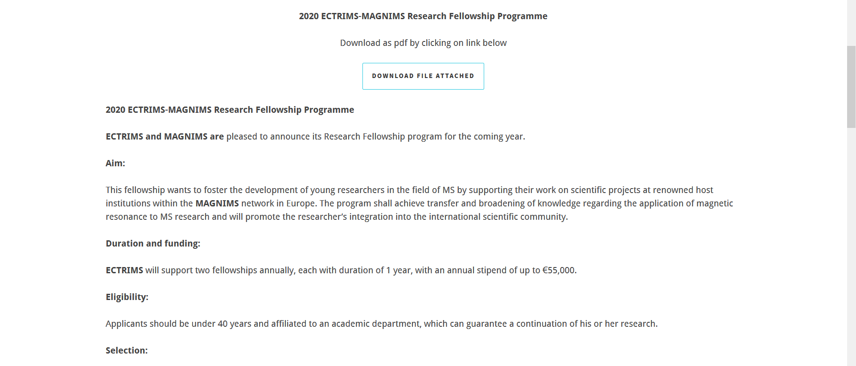
Notes:
BACKUP INFO

